Slide 1
Image fairness and domain adaptation
Keith Burghardt
Feb. 12, 2024

Slide 2
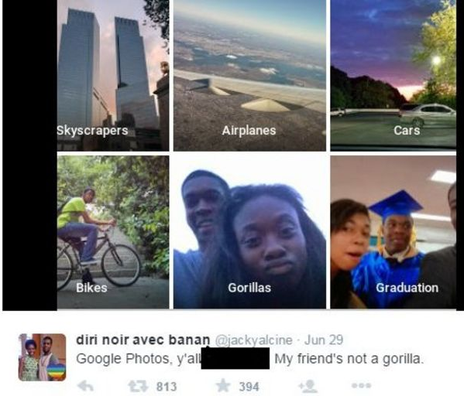
What do we mean by image fairness?
Fairness metrics applied to images are particularly fraught
Visual cues create accurate models
…but same features harm anyone who “looks different” from training set
Hard to know where bias lies (high dimensional data)
Image fairness less abstract but issues appear throughout AI (e.g., NLP)

Slide 3
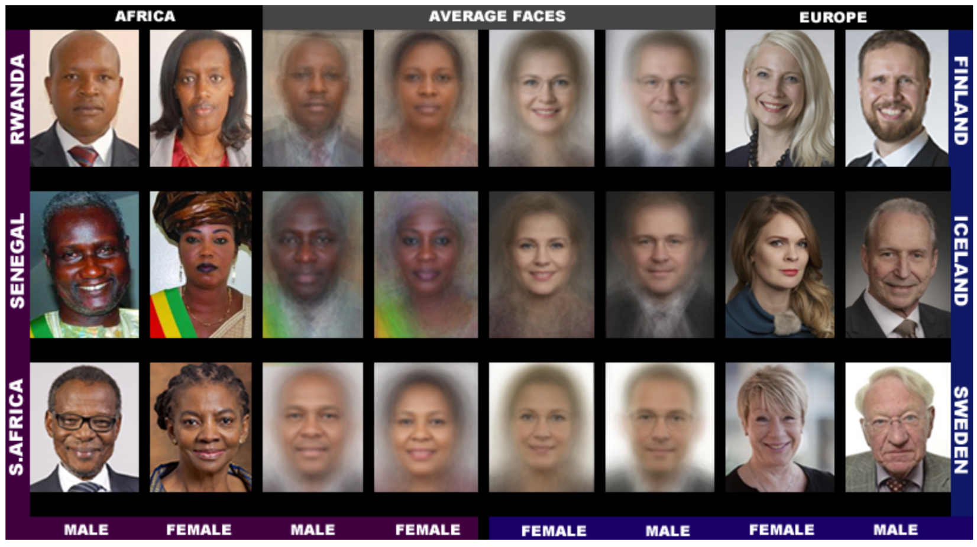
Models are poorly trained on minorities
Task: predict gender from images
Caveat: this research does not explore trans and non-binary individuals
Models were likely trained on mostly white images
Normal test images are ~80% white
Buolamwini and Gebru, 2018

Slide 4
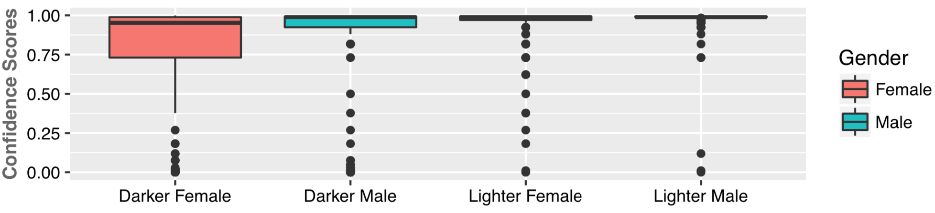
AI Fairness and Gender
Determining gender is not a solved problem
Commercial algorithms perform poorly on:
Women
Darker-skinned individuals
Buolamwini and Gebru, 2018

Slide 5
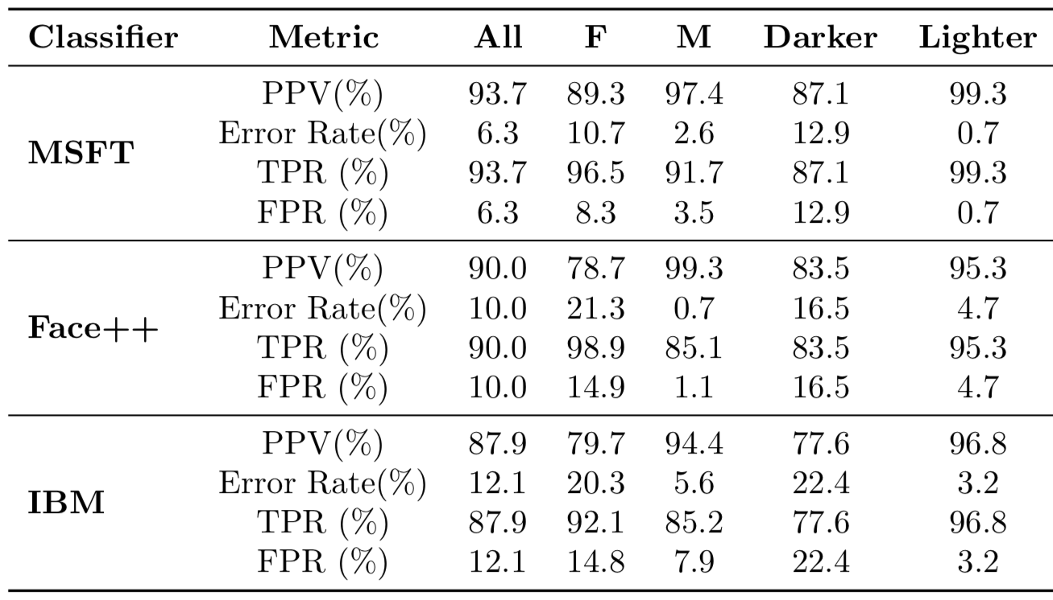
Poor data = poor predictions
Female Gender Misclassified More

Slide 6
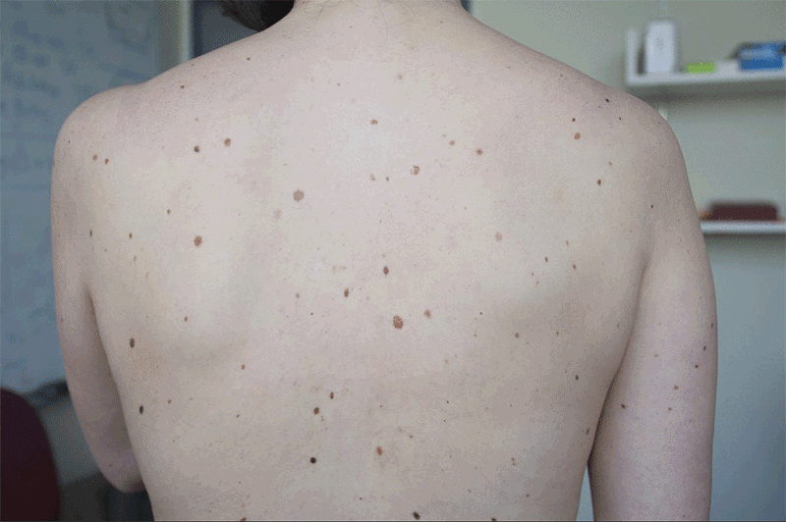
Detecting skin cancer
https://news.mit.edu/2021/artificial-intelligence-tool-can-help-detect-melanoma-0402

Slide 7
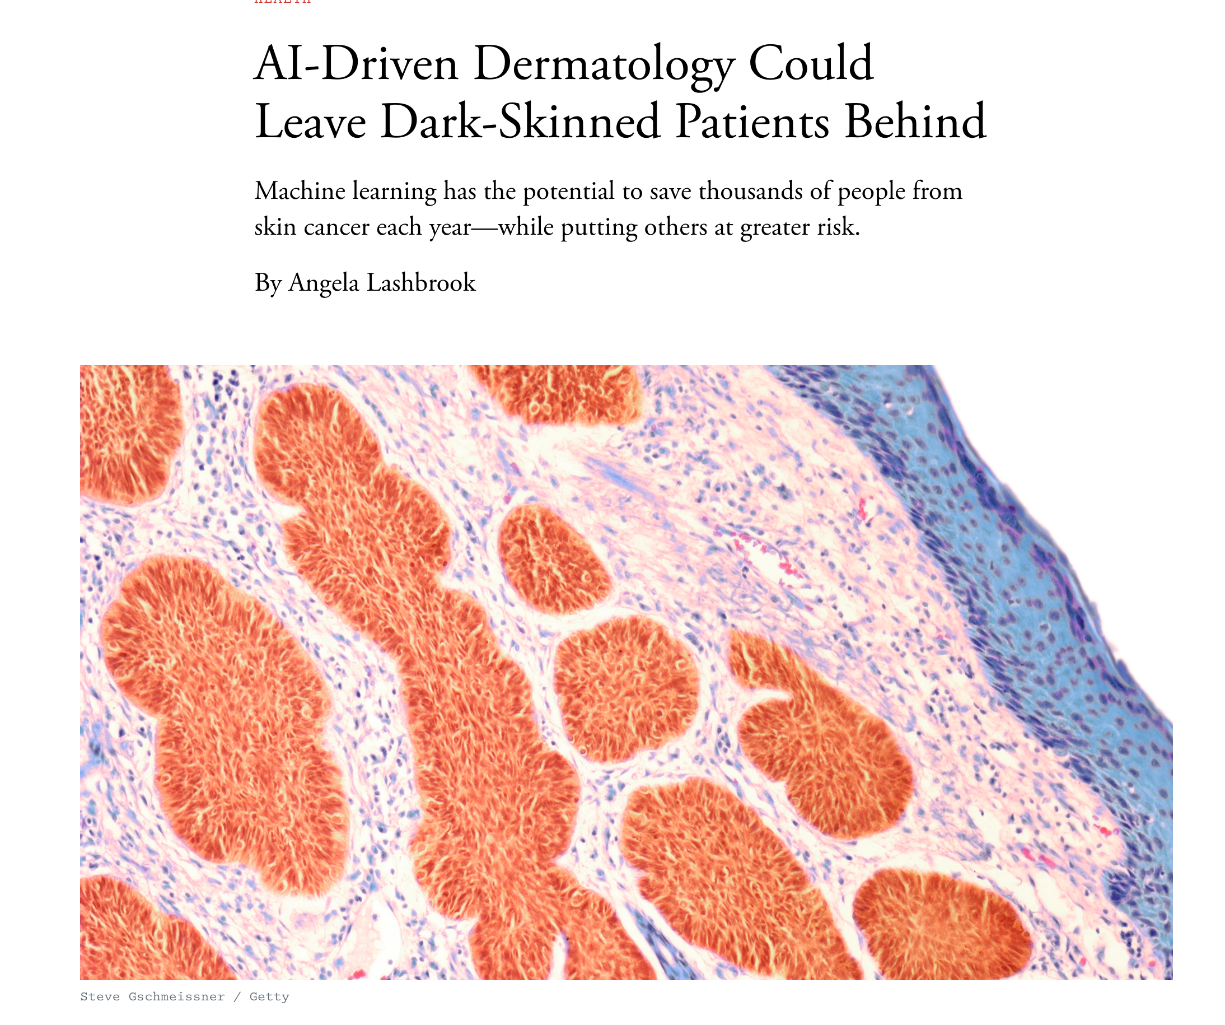

Slide 8
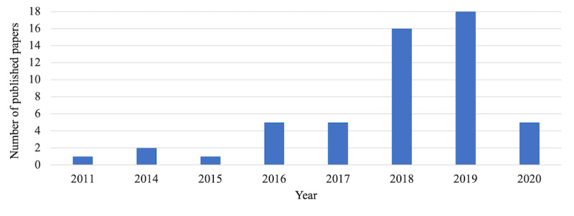
“…Similarly, an investigation into data biases in the literature (imbalanced data with respect to diagnostic classes, patient ethnicity and skin color, gender, etc) is left as a direction for future studies.”
Dozens of papers, few on bias
(warning that I will show 3 images of skin cancer)
Takkidin et al., 2021

Slide 9
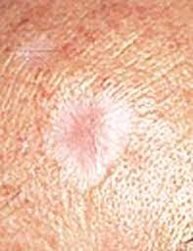
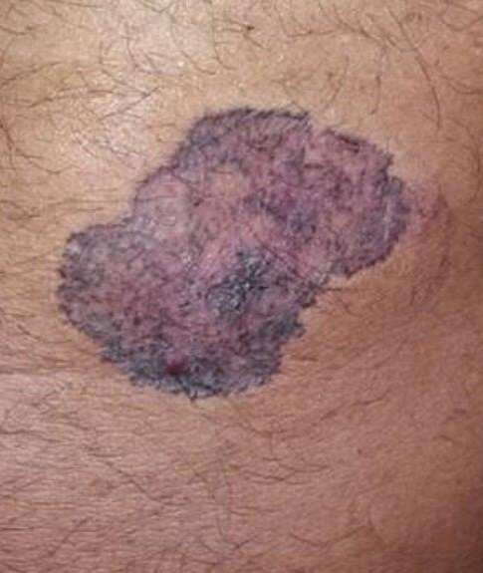
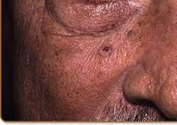
Systematic review of data
“…most (11 [79%]) originated from Europe, North America, and Oceania exclusively. Most datasets (19 [91%]) contained dermoscopic images or macroscopic photographs only. Clinical information was available regarding age for 81 662 images (76·4%), sex for 82 848 (77·5%), and body site for 79 561 (74·4%). Subject ethnicity data were available for 1415 images (1·3%), and Fitzpatrick skin type data for 2236 (2·1%).”
Wen et al., 2021

Slide 10
Signs of cancer are not a universal
Lighter skin shows dark patches
Darker skin looks more purple
AI models could confuse dark skin with cancer
We want a model that works well across demographics:
How do we find universal features of skin cancer?
How do we address data imbalance (little data on dark skin)?

Slide 11
Fairer models across datasets
Pre-processing: Make data fairer
Make models fairer
Post-processes model predictions

Slide 12
Fairness methods for computer vision
Invariance
Most common*
Goal: make model perform equally well across demographics
Challenges: unlabeled data (typical in NLP and images)
Examples
Detecting gender in data if we do not know race
Detecting outcomes given latent bias (e.g., model performs poorly on some African ethnicities but not others)
Research questions
How do we know if unlabeled data is fair?
What demographics should we control for?
*c.f., Mehrabi et al., A Survey on Bias and Fairness in Machine Learning. 2019

Slide 13
Pre-processing: Make data fairer
Remove biases from features (e.g., create representative data, or remove skin color from data)
Examples:
Fair PCA
Linear feature debiasing
How would one remove biases in data on, e.g., cancer?
How to distinguish extraneous information (skin color) from cancer (which affects skin color)
Confounders: bruises, scabs, moles all look similar

Slide 14
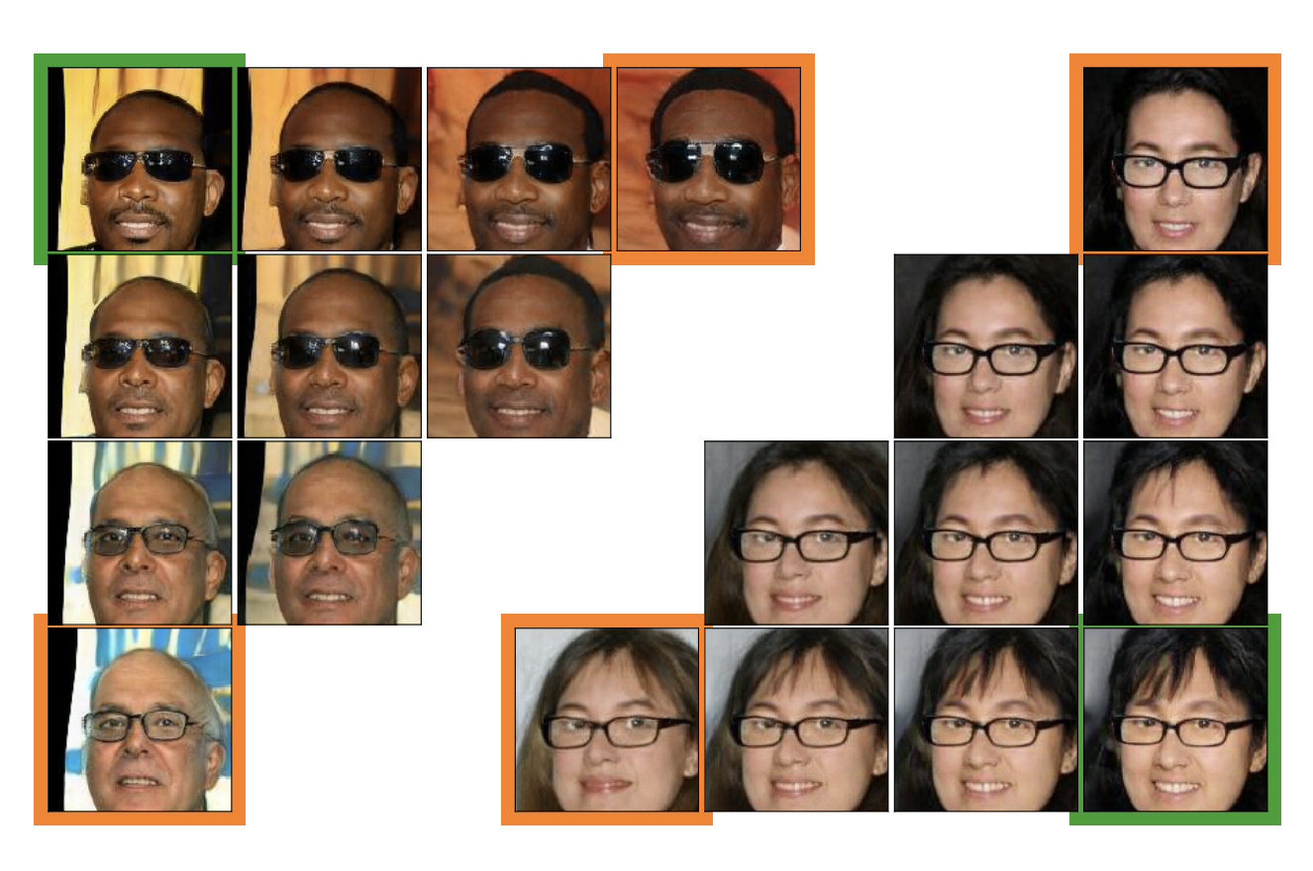
Data augmentation without new data

Slide 15
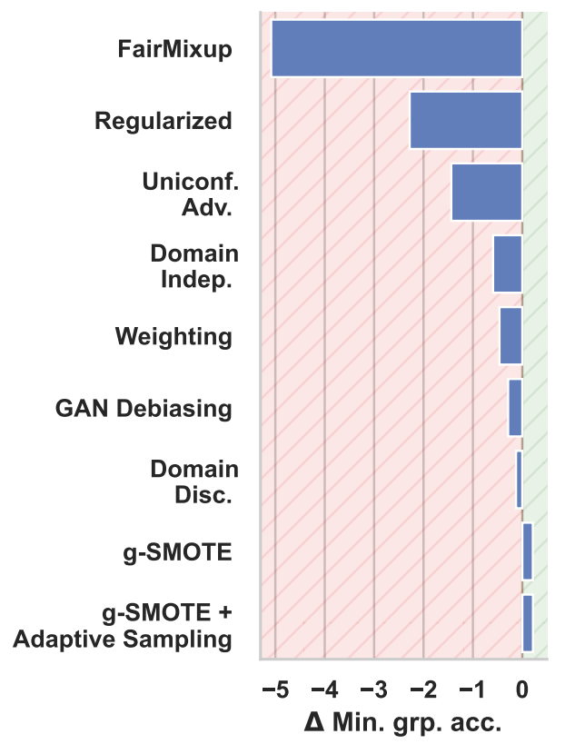
g-SMOTE
Given a datapoint and two neighbours linear interpolations in GAN latent space yield diverse images.
Nearest neighbours are chosen to share the target attribute (“eyeglasses”).
They give all interpolated images the same attribute label value.

Slide 16
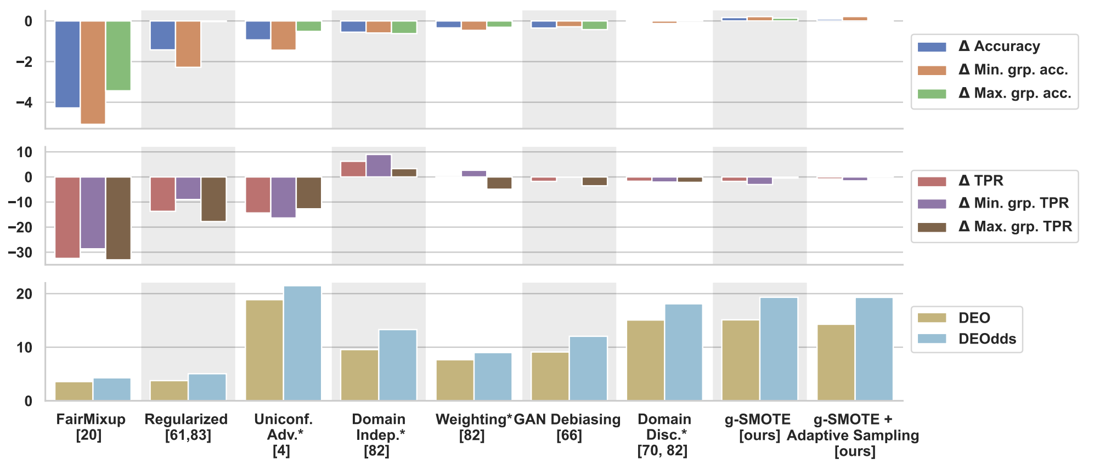

Slide 17
Possible reasoning behind performance
More data always helps a model!
Question for your own research:
Can one model perform well across diverse data? (we will get back to this)
Caveat:
Some demographics may have outcome variables that are easier to predict
Method improves representativity but not biases intrinsic to model

Slide 18
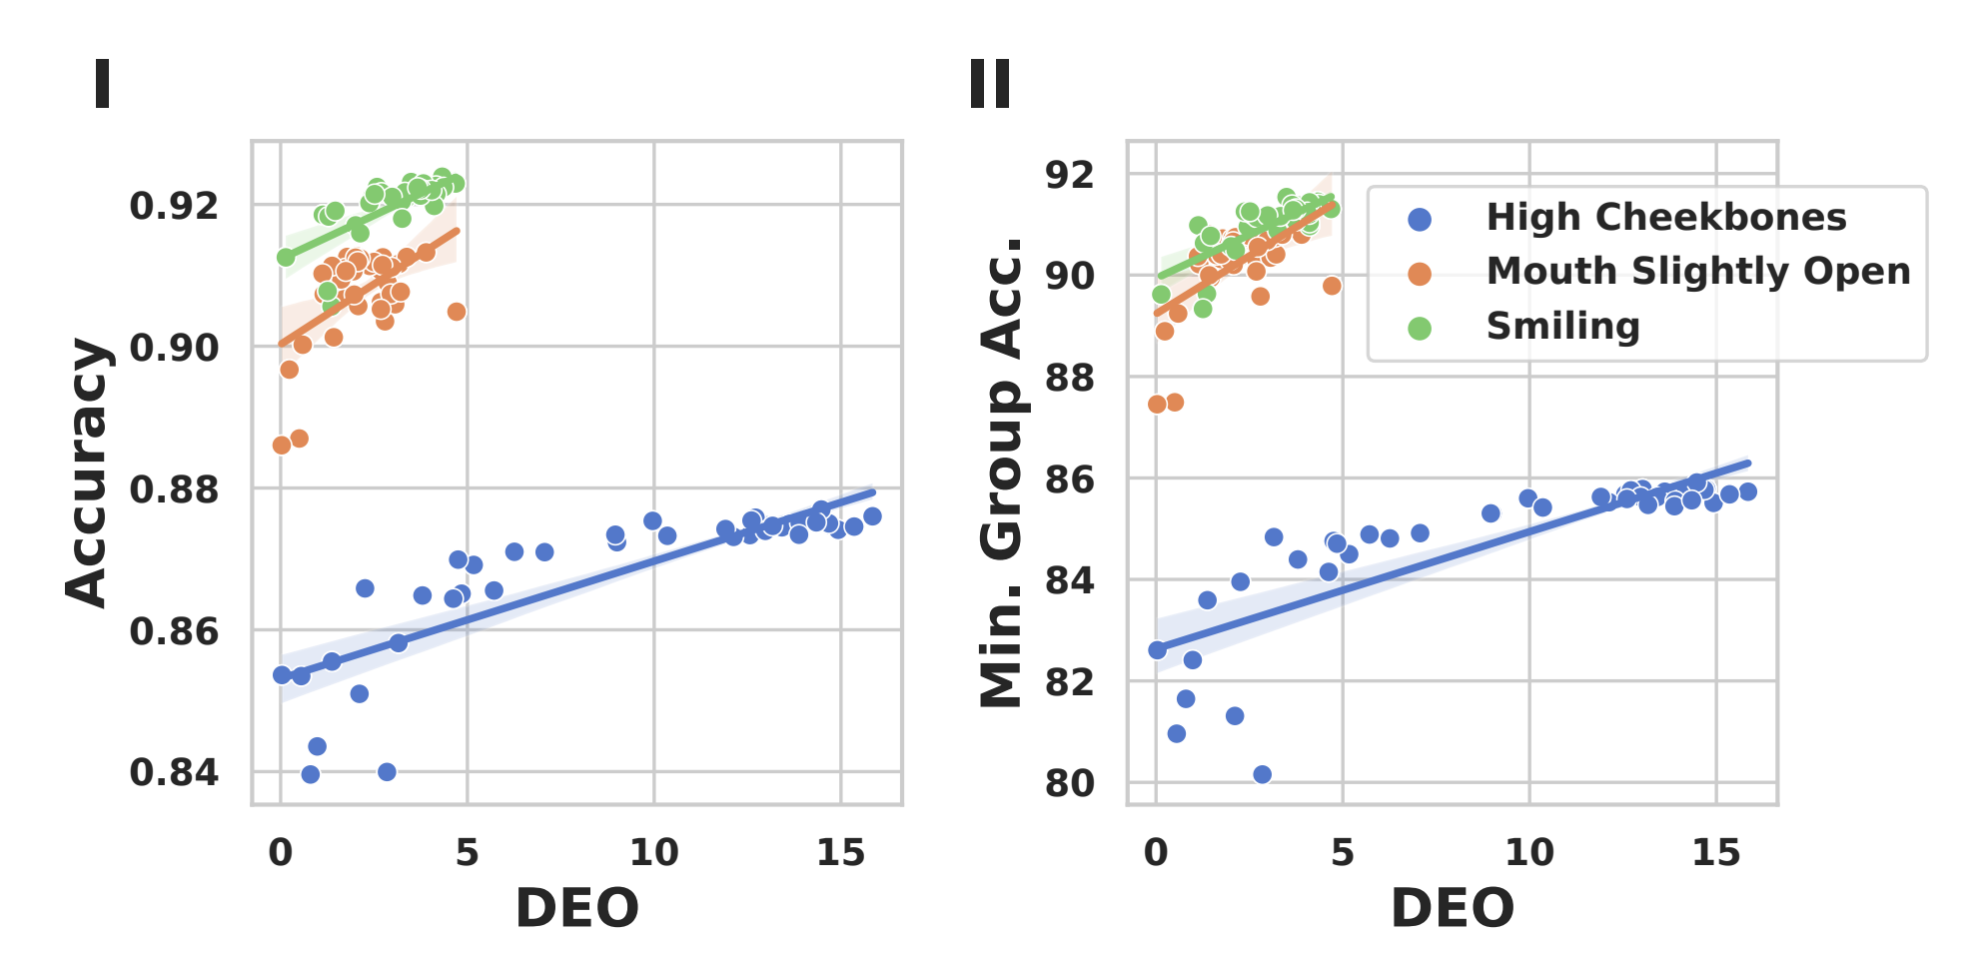
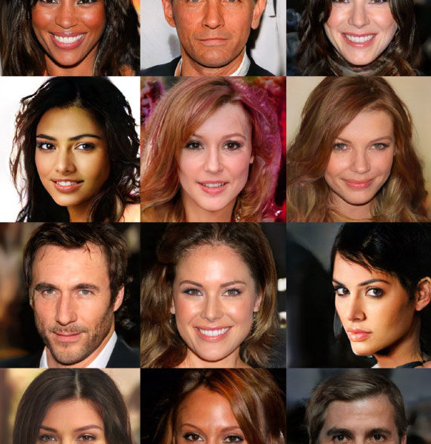
2. Make models fairer (most common)
Fairer classification & regression (e.g., adversarial, regularization,…)
“Price of fairness”: we cannot have an optimal model that is fair
What if bias exists in unlabeled data?
Difference in Equal Opportunity
Difference in Equal Opportunity
Zietlow et al., 2022

Slide 19
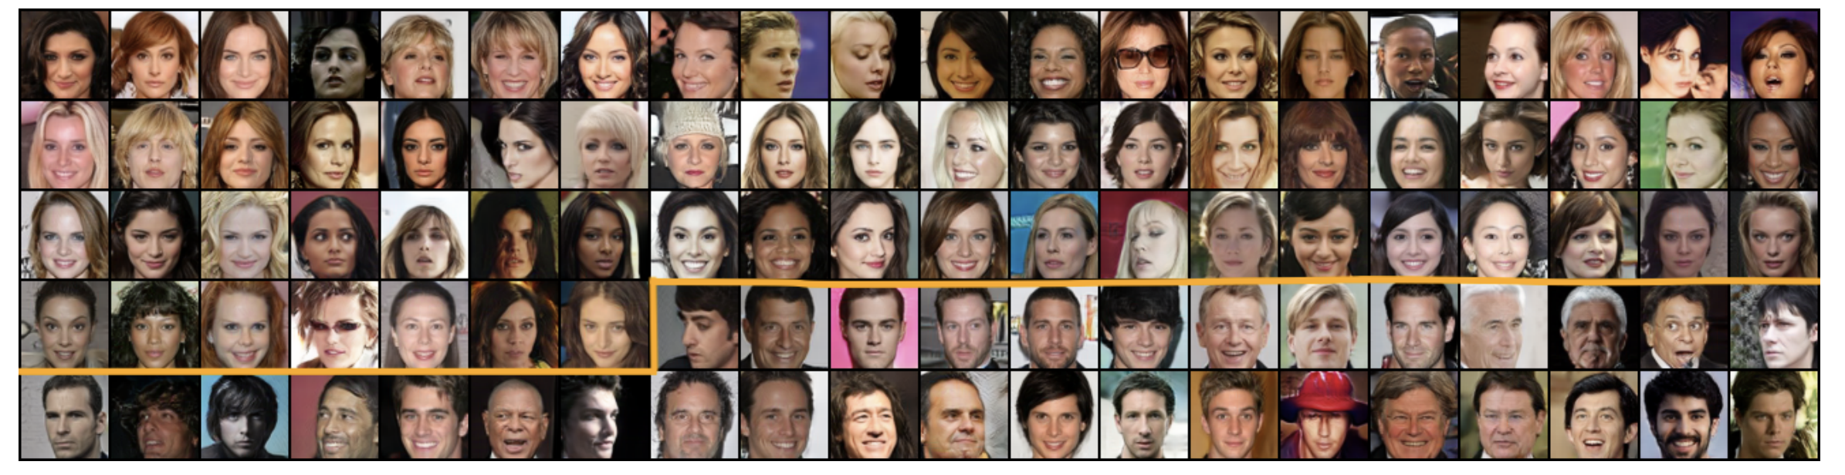
Example models
Biases in generating faces (most are white, female)
Women
Men
Choi et al., 2020

Slide 20
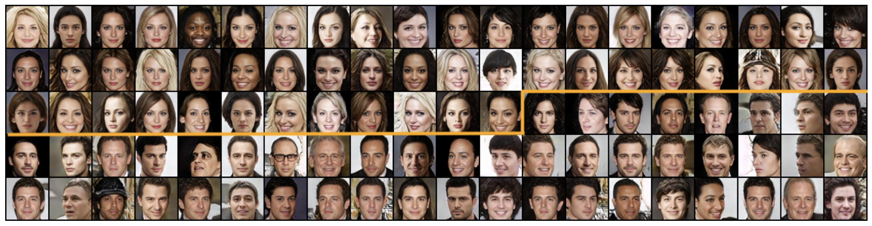
Generating fairer samples with weak supervision
Women
Men
Create more faces of each gender

Slide 21
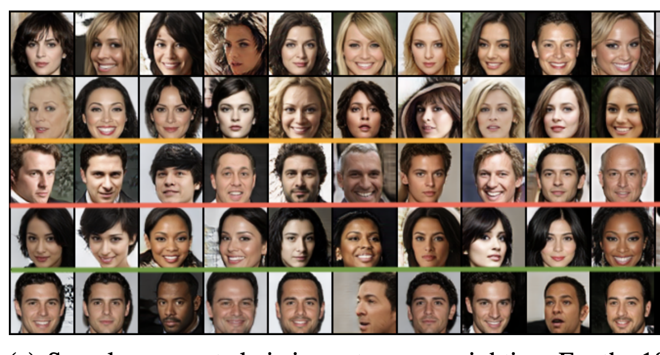
How method works
Improve representative data
Generate images conditional on demographic (detect demographic within training dataset, conditional on imperfect label)

Slide 22
3. Post-processing (least common)
Removing biases from model predictions
Example:
Ensuring model accuracy > X for all subgroups
Develop auditor to detect demographics in training set, find where performance is worst
Change most predictions until accuracy is sufficient across all demographics
Can improve overall accuracy without new data or models!
Allows for systematic auditing of data

Slide 23
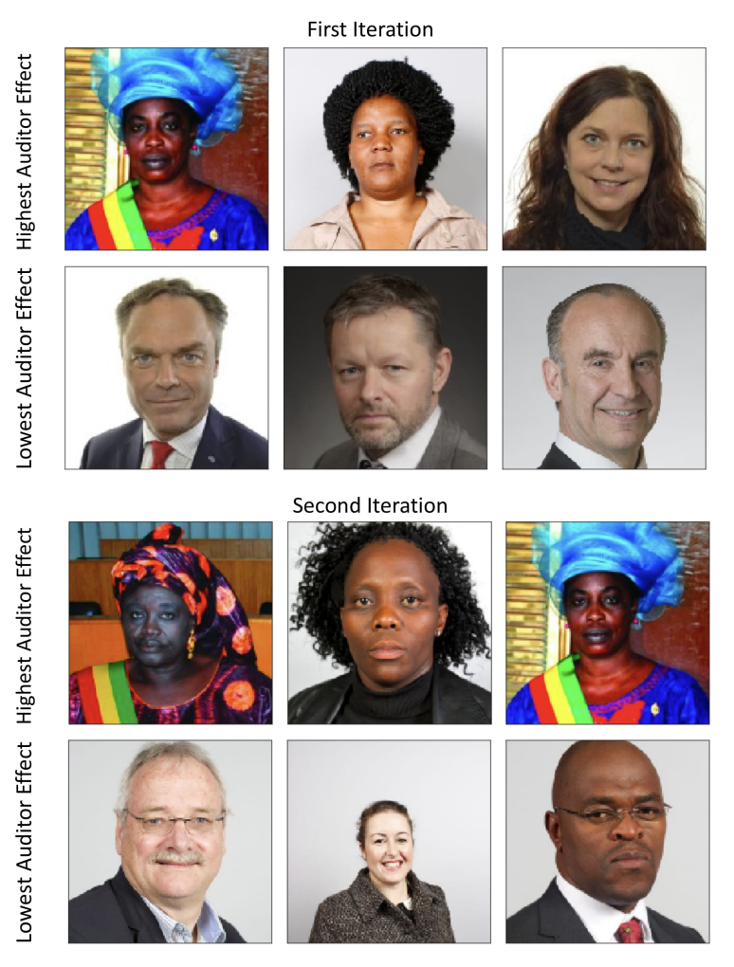
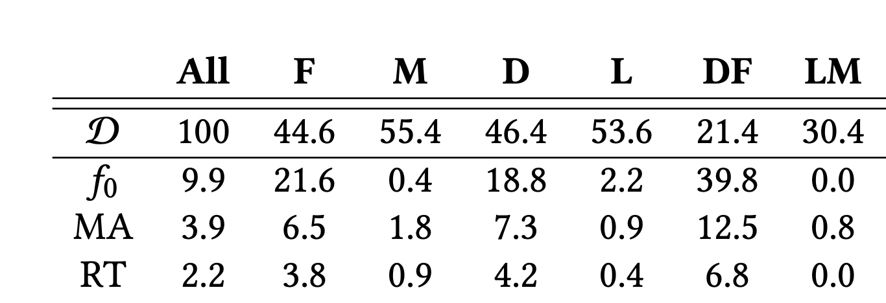
Classification error
Initial model
Postprocessing reduces error
Almost as good as retraining on each demographic

Slide 24
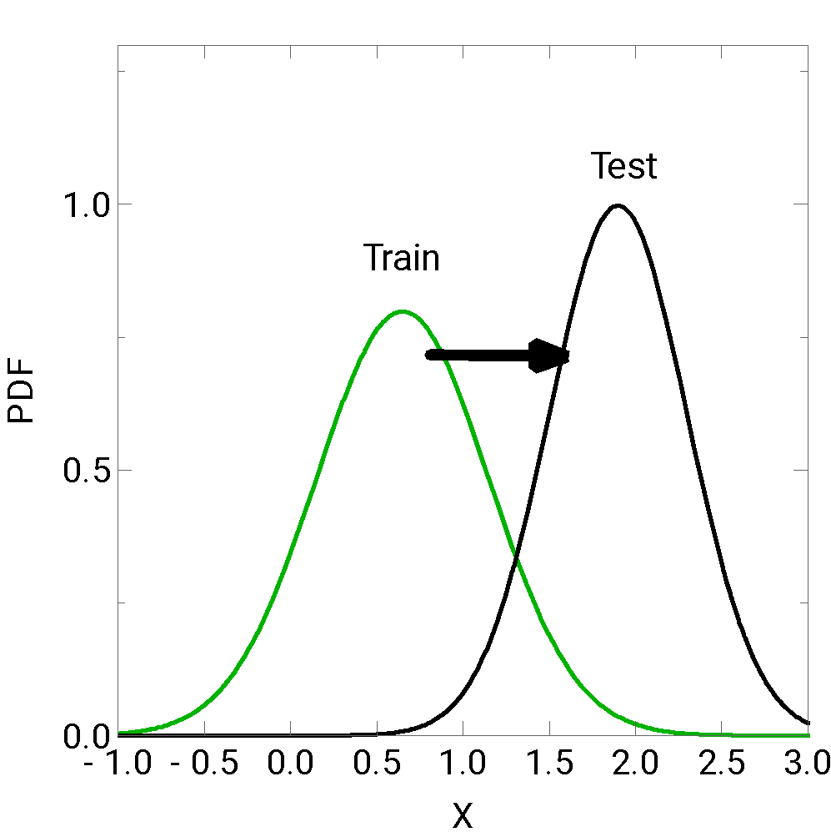
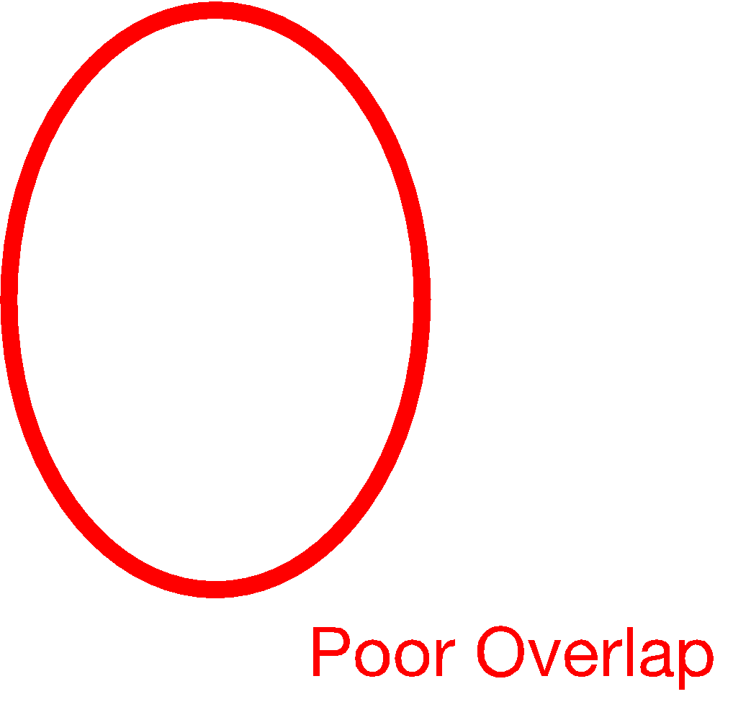
An Alternative Approach
Protected groups create different feature distributions
One issue: train mostly on one distribution but test on another distribution
Overlap is poor! Invariant solutions might perform poorly
Solution 1: domain adaptation
Make distributions similar
Solution 2: transfer learning & multi-task learning
Use model from one class to help solve other

Slide 25
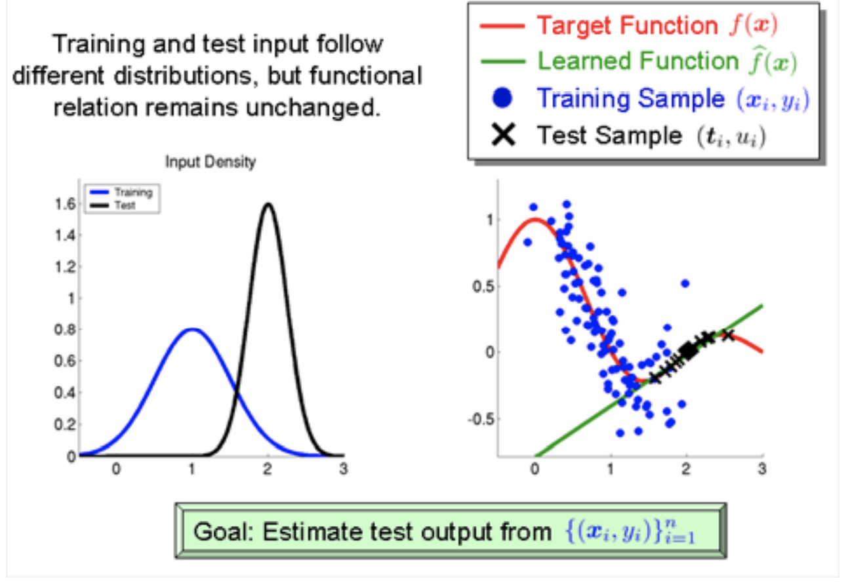
Why Data Shift is Critical: Covariate Shift
https://towardsdatascience.com/understanding-dataset-shift-f2a5a262a766

Slide 26
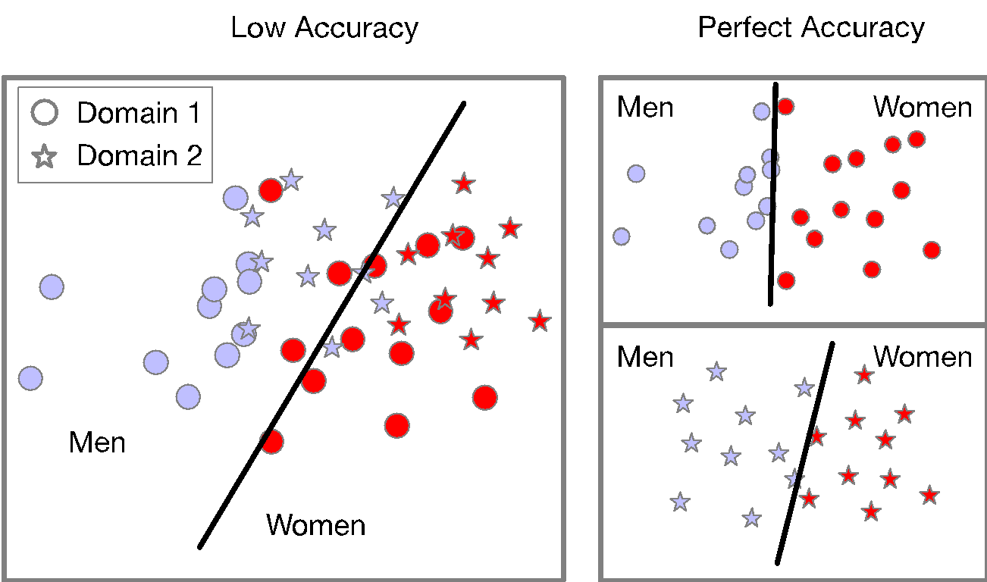
Why Data Shift is Critical: Changes in Priors

Slide 27
Applications
Applications need not be focused on demographic fairness!
Many datasets contain systematic biases outside of social data
Addressing these biases can make a better model
Examples
Predicting built year
Self-driving cars
Reading text

Slide 28
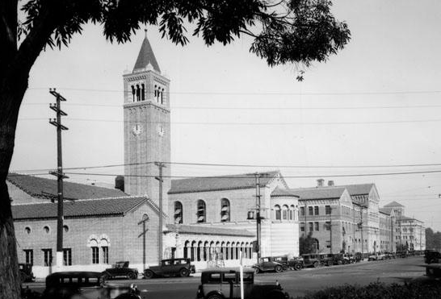
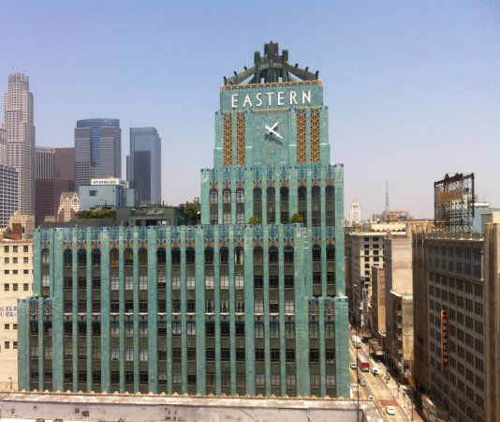
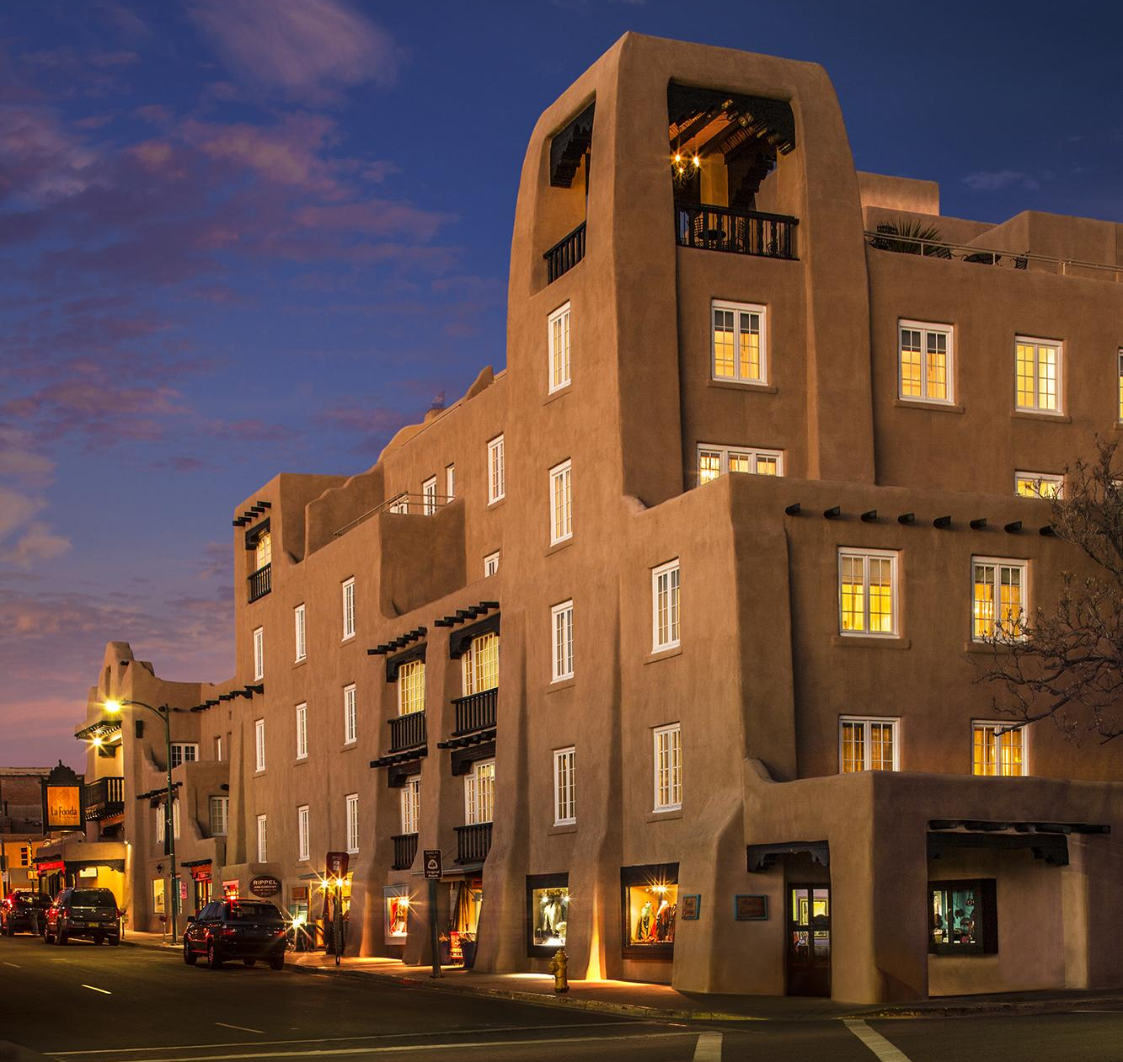
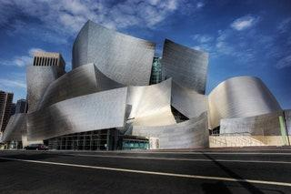
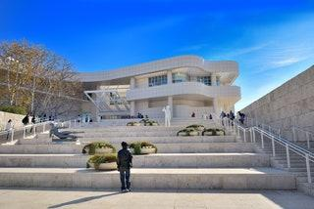
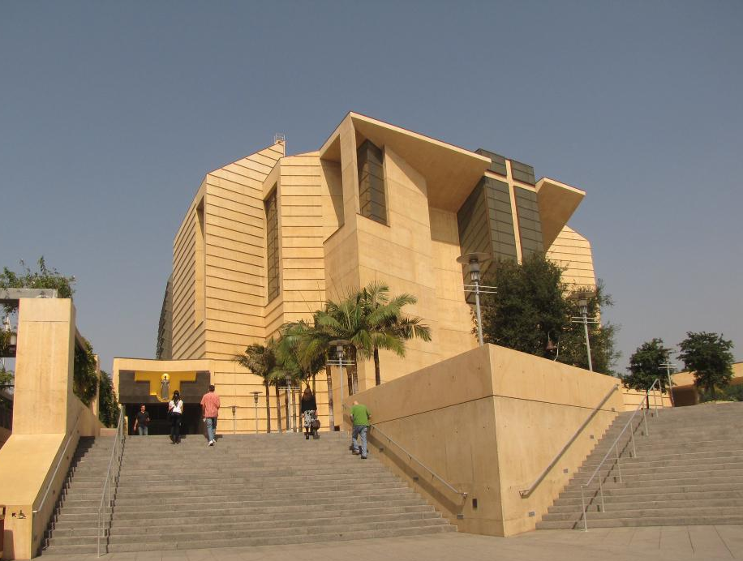
USC Mudd Memorial Hall of Philosophy
1929
Eastern Columbia Lofts
1930
La Fonda hotel
1920-1929
Disney Concert Hall
2003
Getty Center
1997
Cathedral of Our Lady of the Angels
2002

Slide 29
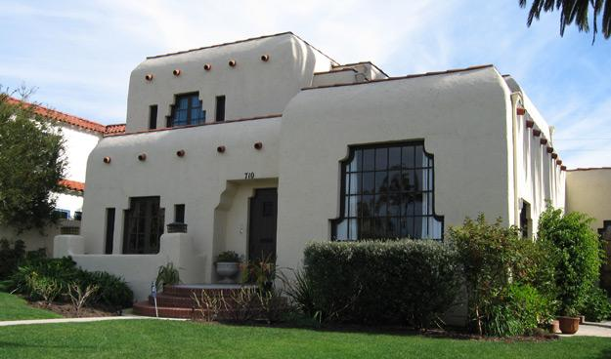
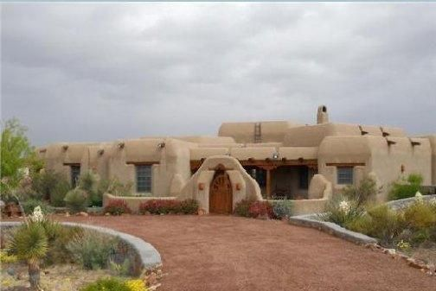
(Above): Pueblo revival architecture
Facades are unique in encoding
Building quality, style
Time period styles
Applying CV to facades helps us understand the art of planning
We can understand the evolution of architecture over time and space
We can fill in gaps from other methods

Slide 30
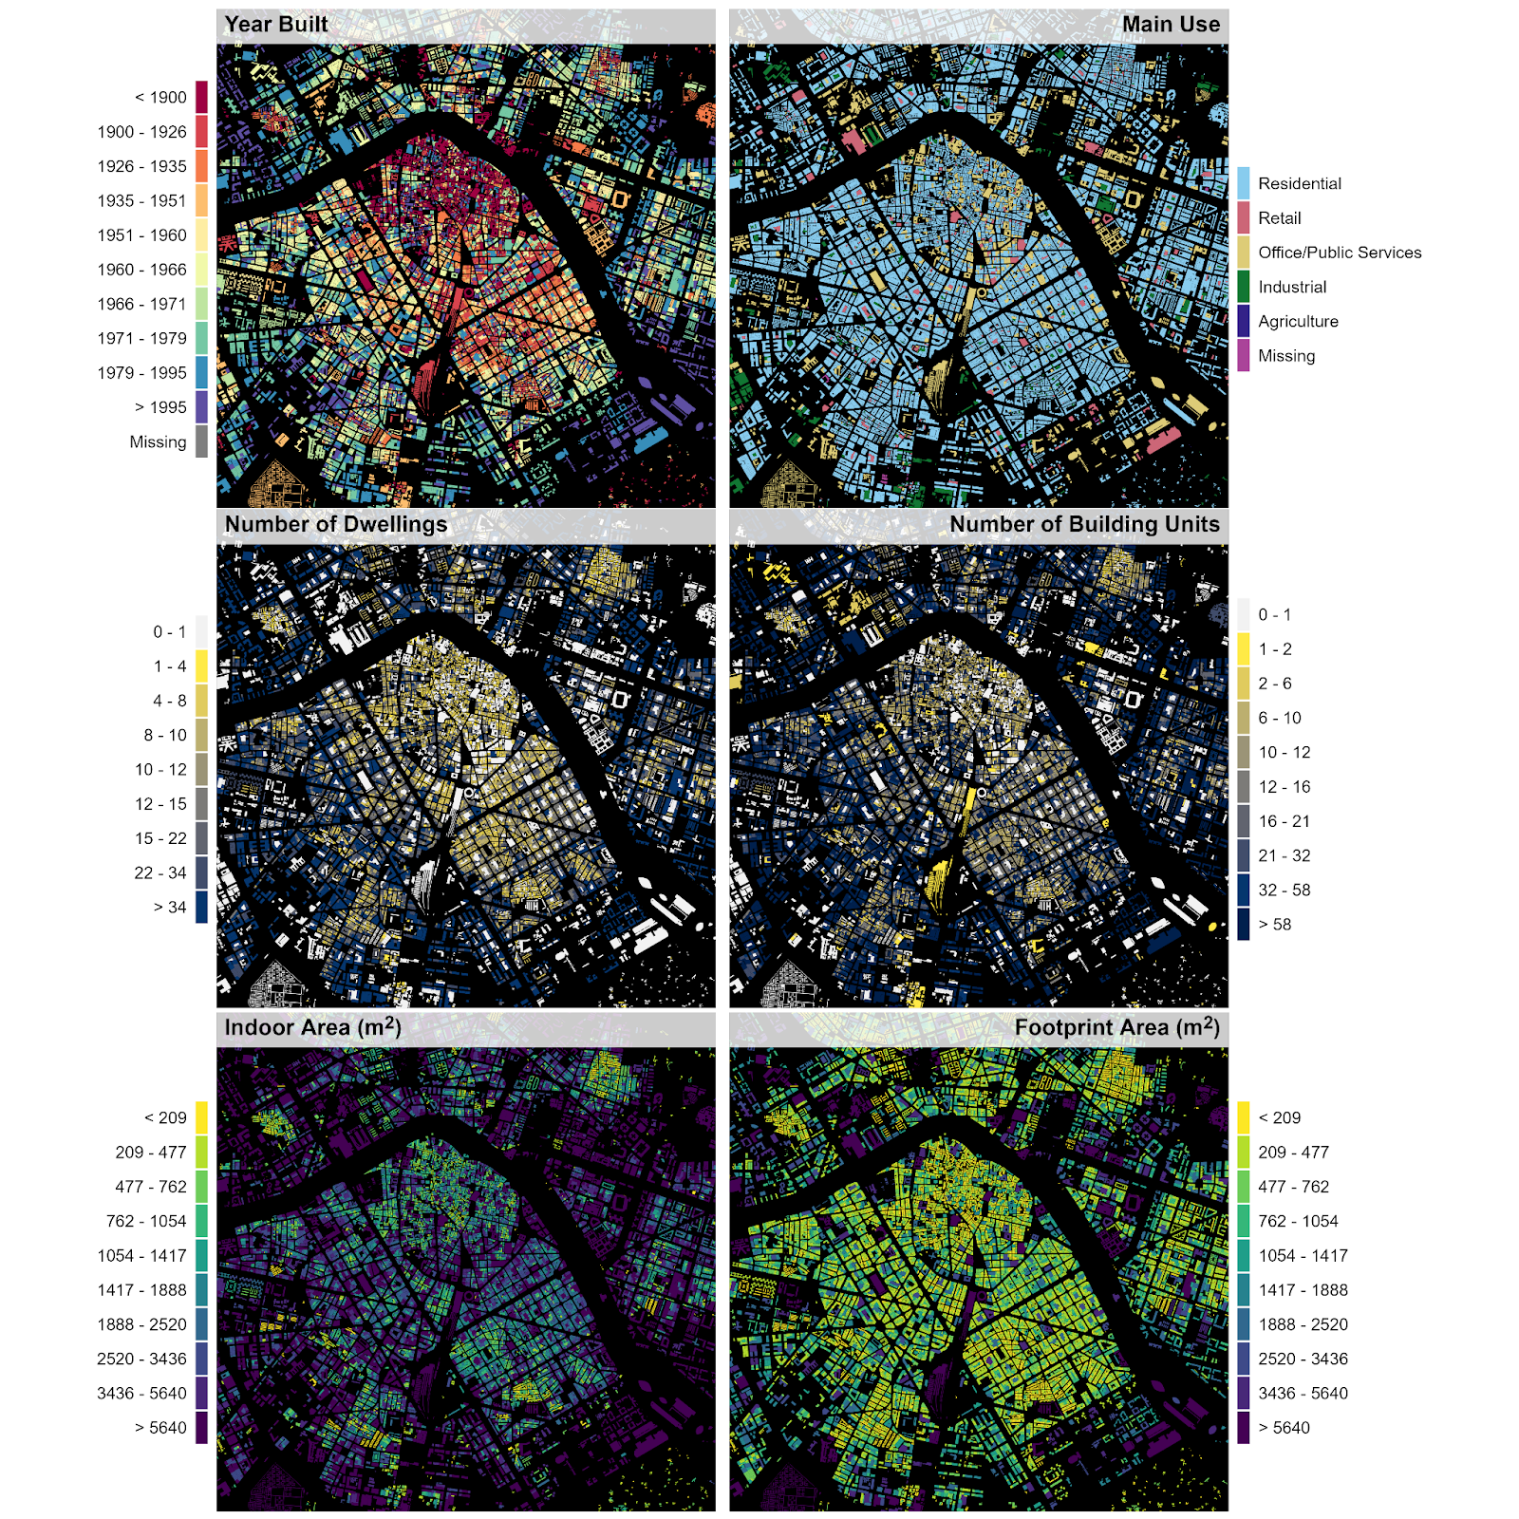
Case Study: Settlements in Spain

Slide 31
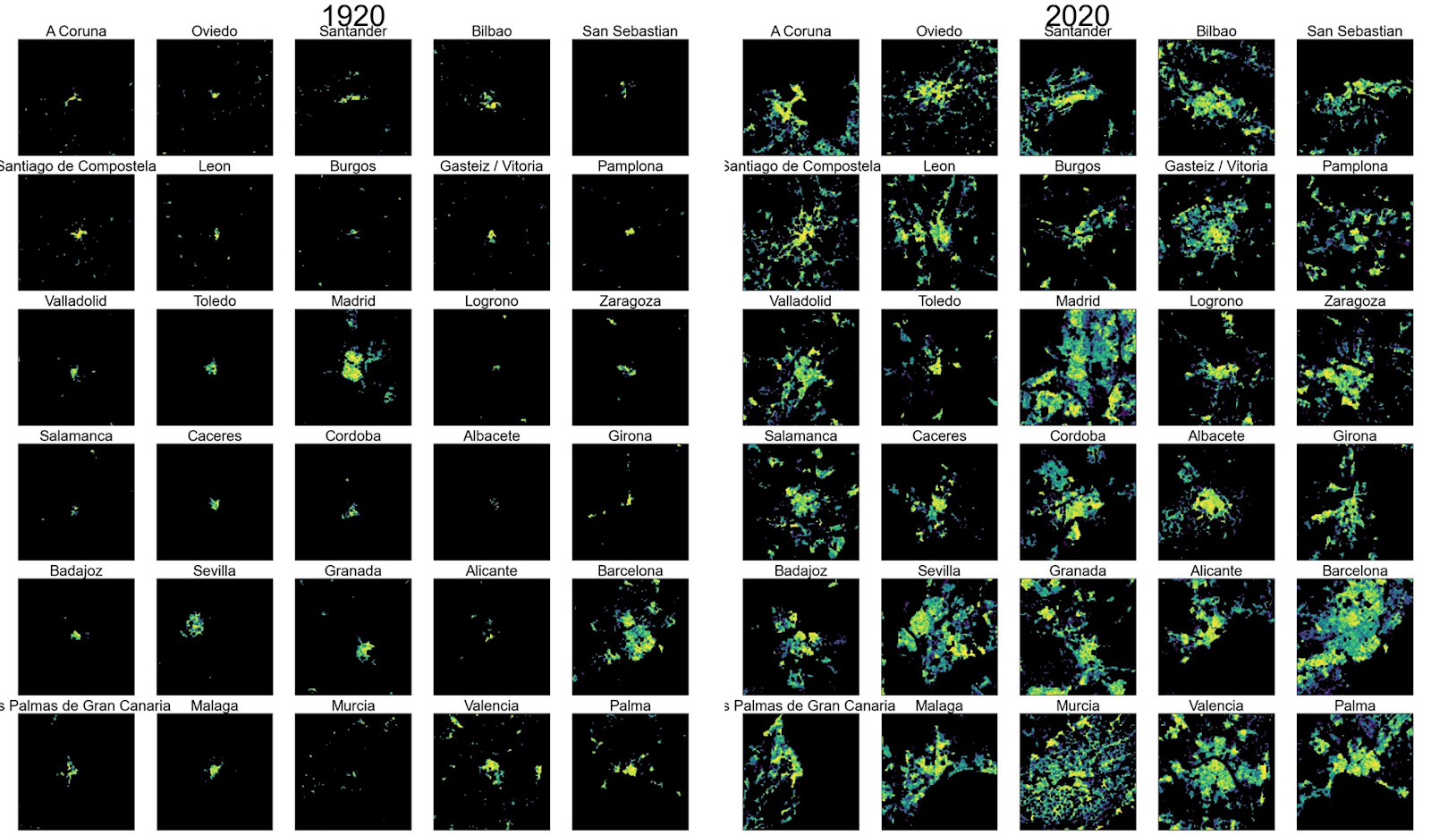

Slide 32
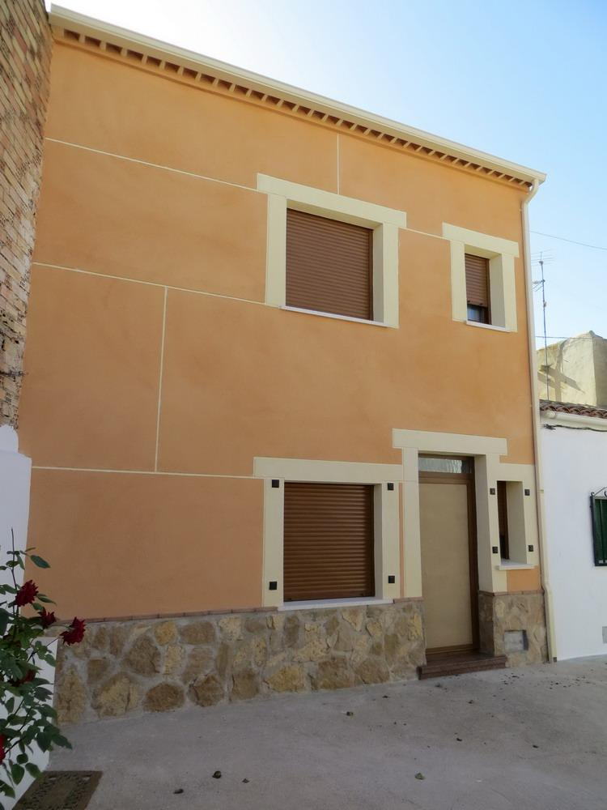
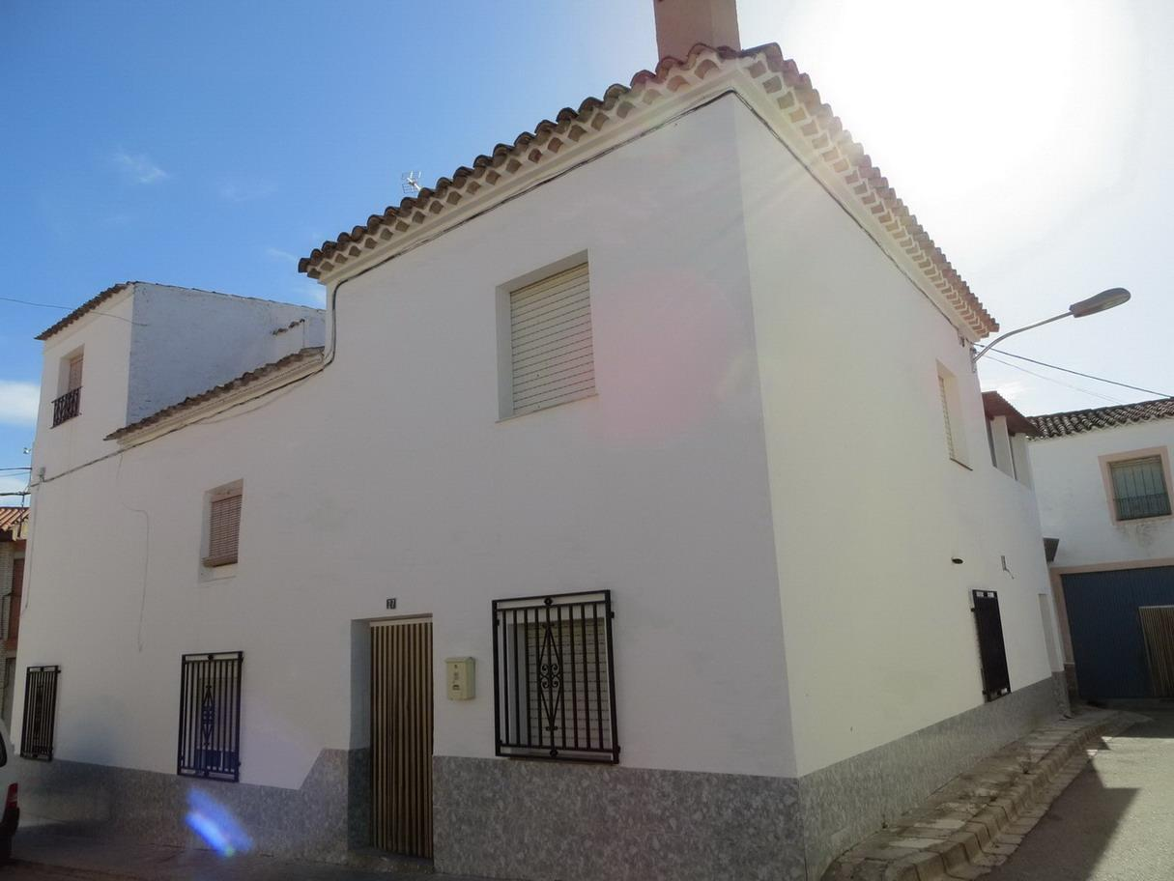
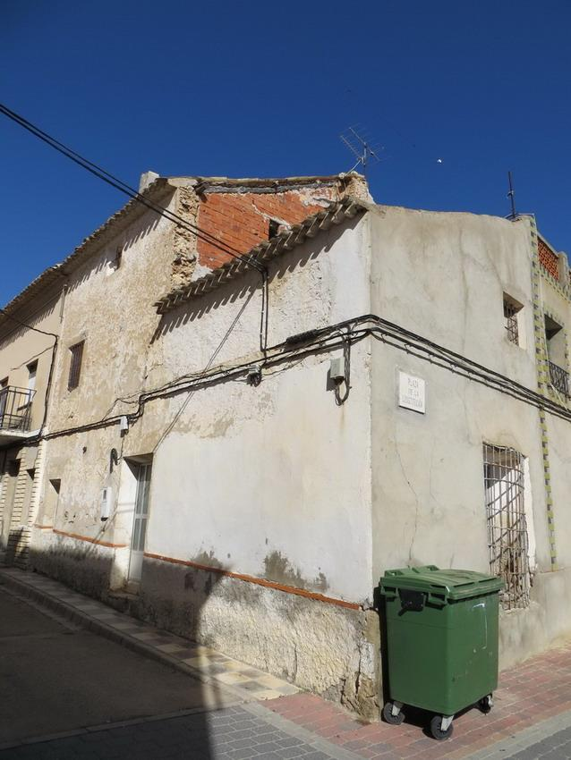
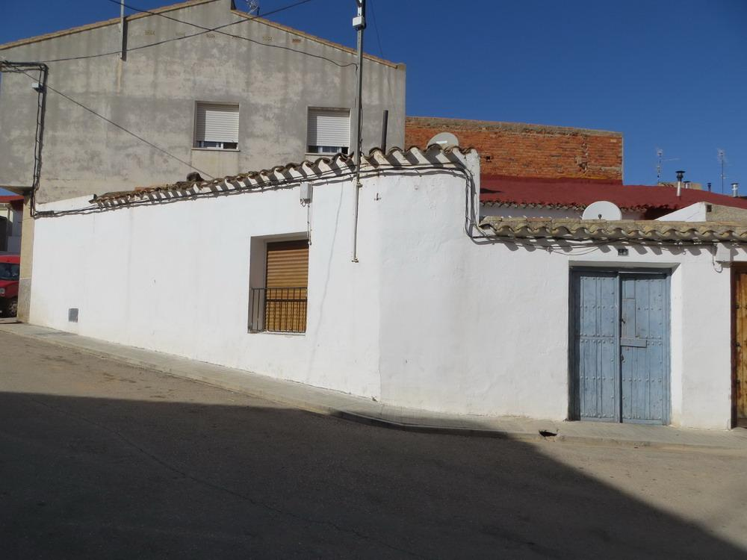
Example: 1920 houses

Slide 33
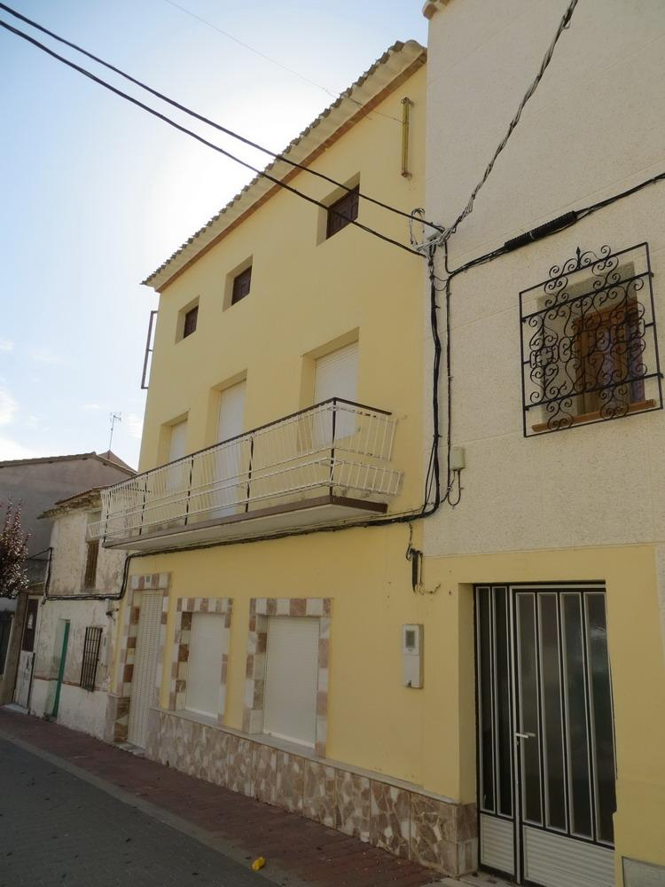
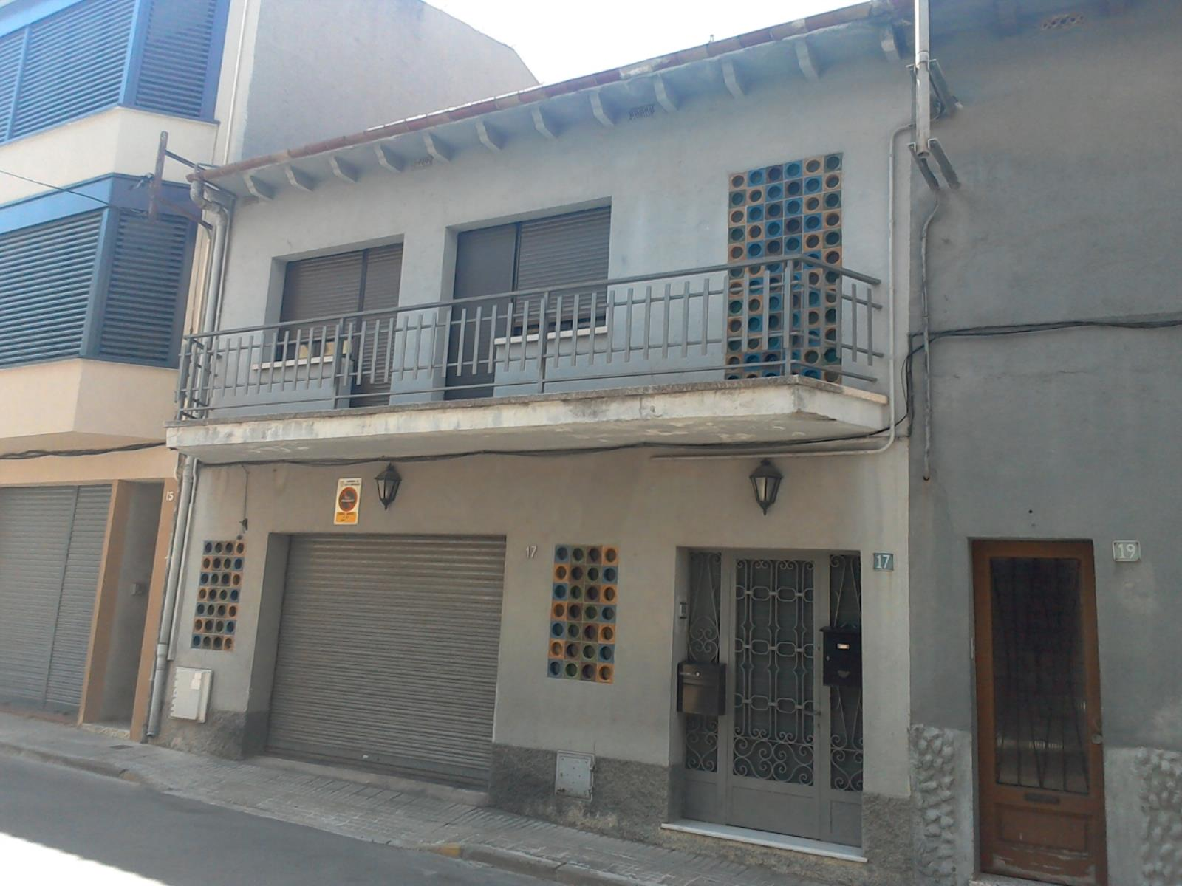
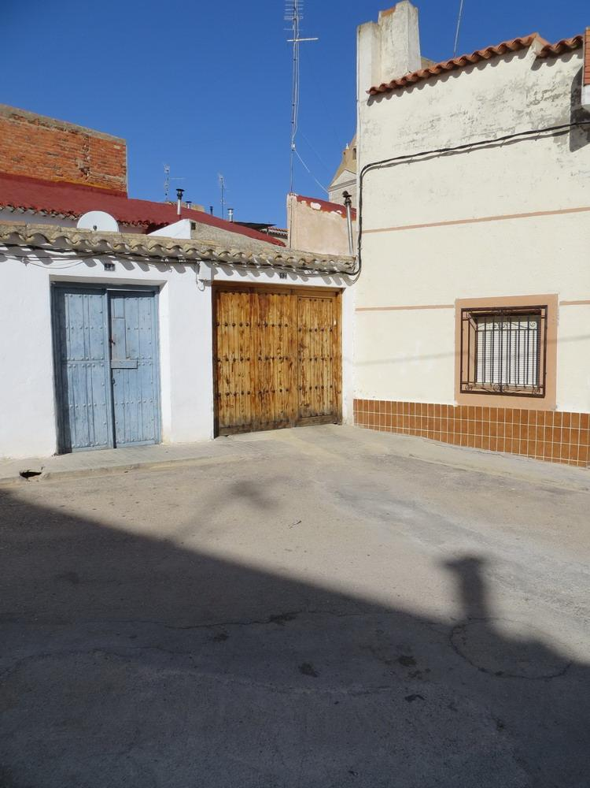
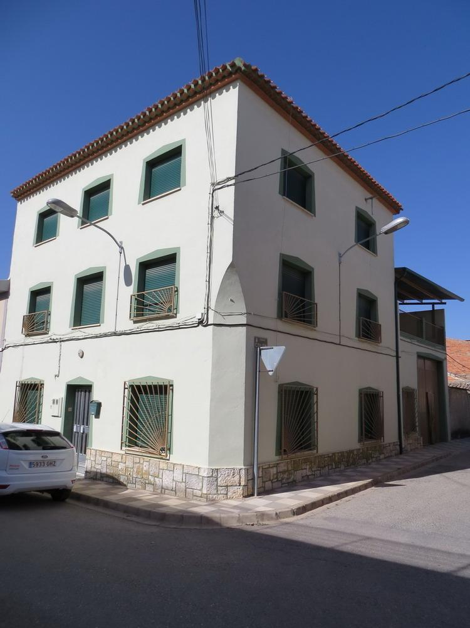
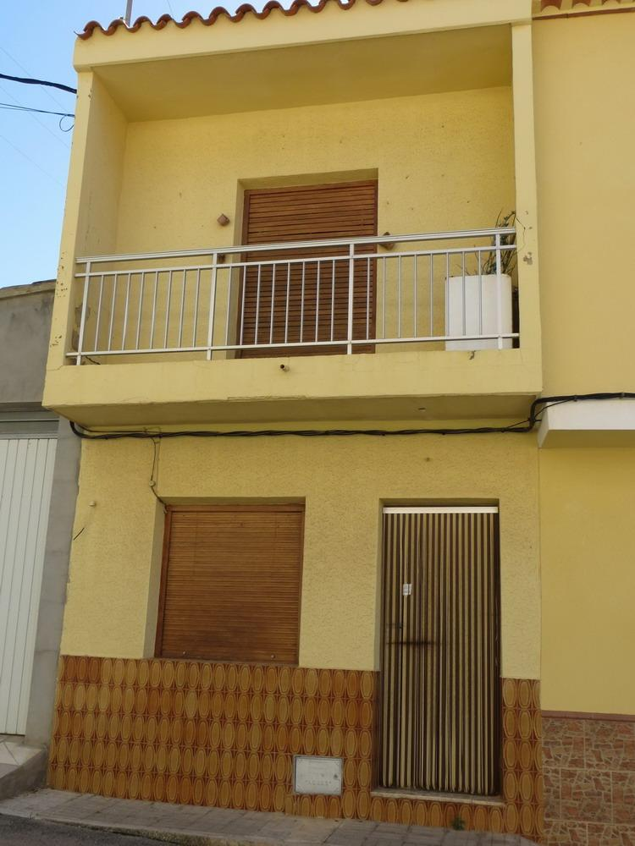
Example: 1975 houses
Differences in
style are subtle!

Slide 34
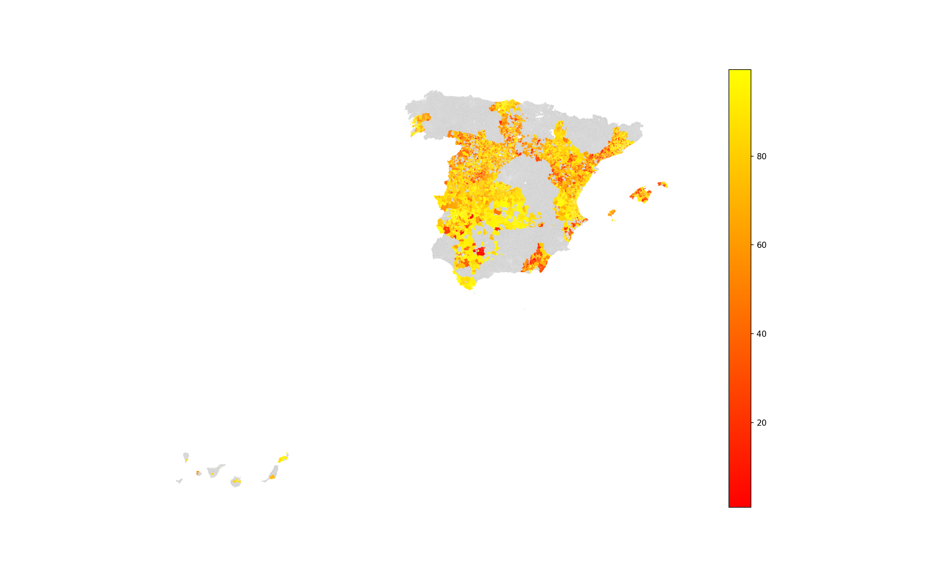
Fraction of data with trainable images
Completeness
100%
50%
0%
~4 million façade images

Slide 35
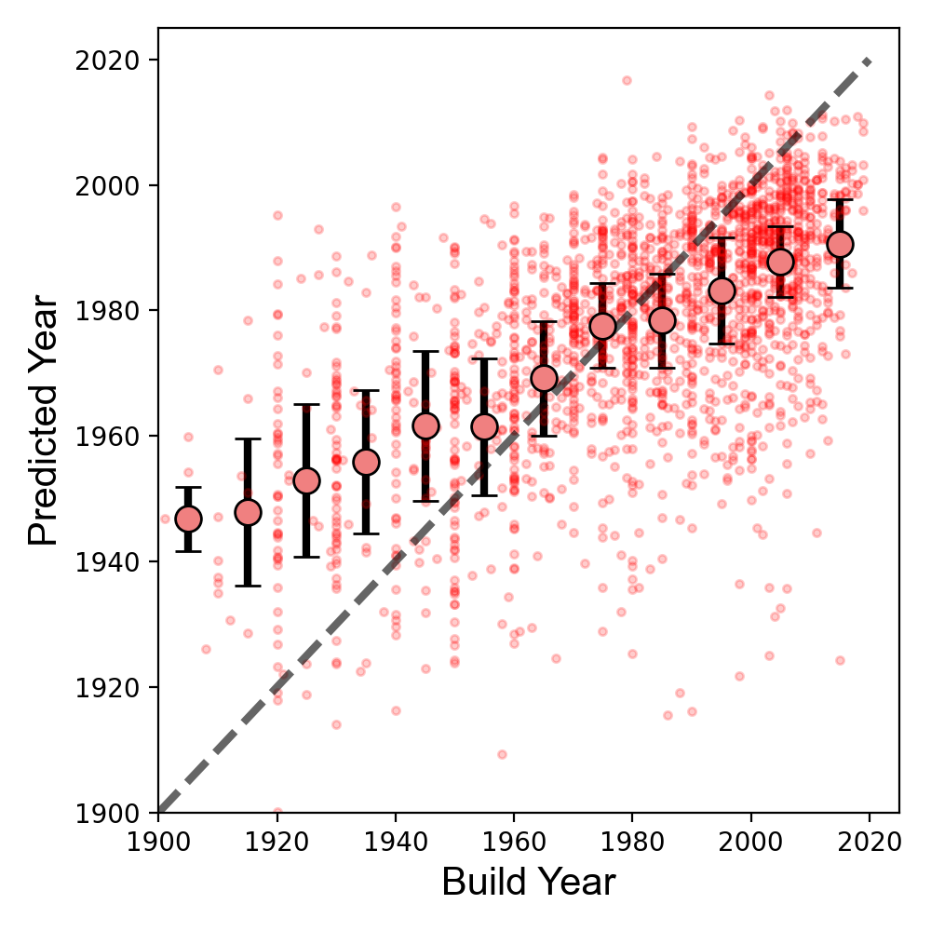
Predicting Build Years From Facades
Across all buildings: dilapidated, commercial, residential (we may look at these separately later)
Across all provinces
Predictions of age: (dots are mean and IQR)
R²=0.32, RMSE = 25 years

Slide 36
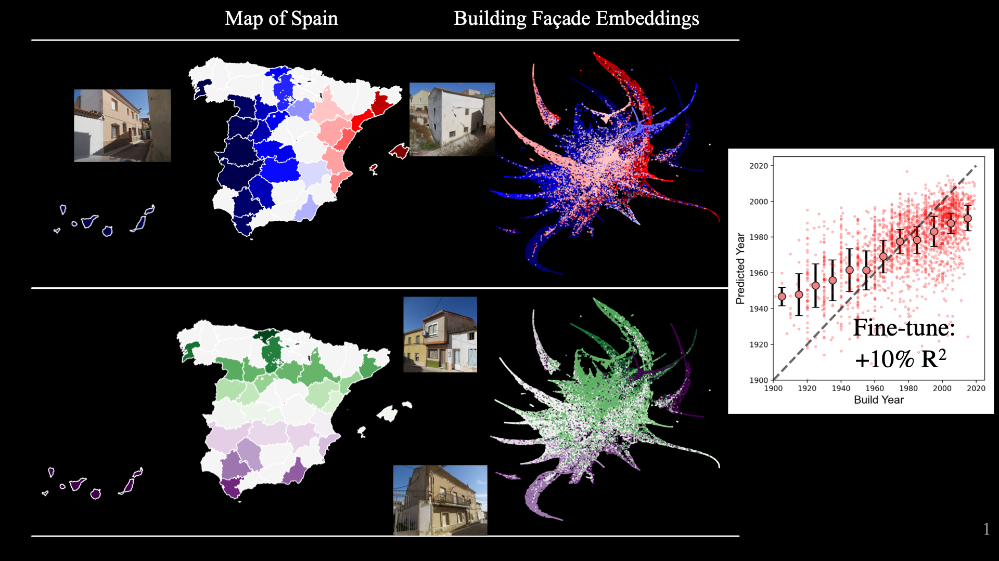

Slide 37
Mixture of Experts (MoE)
We can use machine learning to predict provinces from images alone
These predictions can be embedded into 2 dimensions
We can use images to predict latitude and longitude of building! (top@1 within 1 province or +/- 60 km/40 miles)
Deviations from lat/long show cultural similarities (e.g., Canary islands facades are similar to Balearic islands facades)
Mixture of Experts:
Send geolocated images to fine-tuned province-level models
Unweighted RMSE among a few fine-tuned provinces is 23 years (~10% drop)

Slide 38
Overall results
Location, architecture matters (biases need not be demographics)
Ignoring this bias produces worse results
Location is one bias, but more work would need to find others
E.g., creating an architecture detection method, control for this
Ways to address this bias
Domain shift methods (e.g., fine-tuning)
What other ways can you think of?
Example: increase representativeness of data? Add error due to location into loss function?

Slide 39
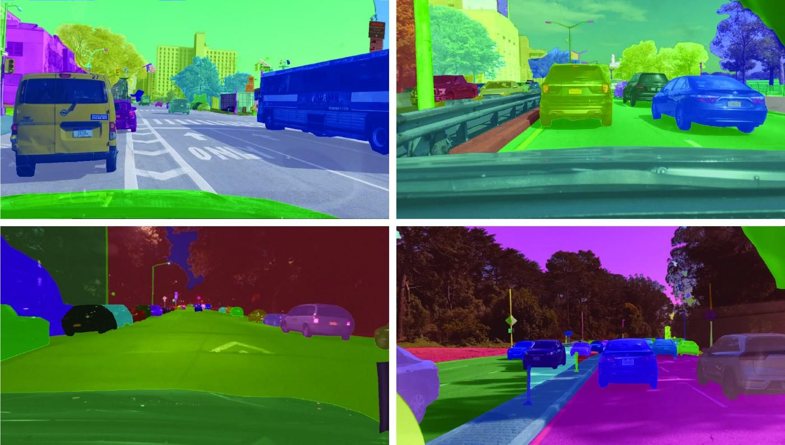
Self-driving cars and biases

Slide 40
How self-driving cars work
AI models need to distinguish the road from cars or children
Models use image segmentation (e.g., UNet) to label each pixel as a set of categories
Realistic data is very expensive ($20/image x 1000s of images) and needs to work across a variety of domains
…which is why fully self-driving cars are so bad in urban environments
1000s of images of daytime traffic work poorly when we are in nighttime or rainy environments

Slide 41
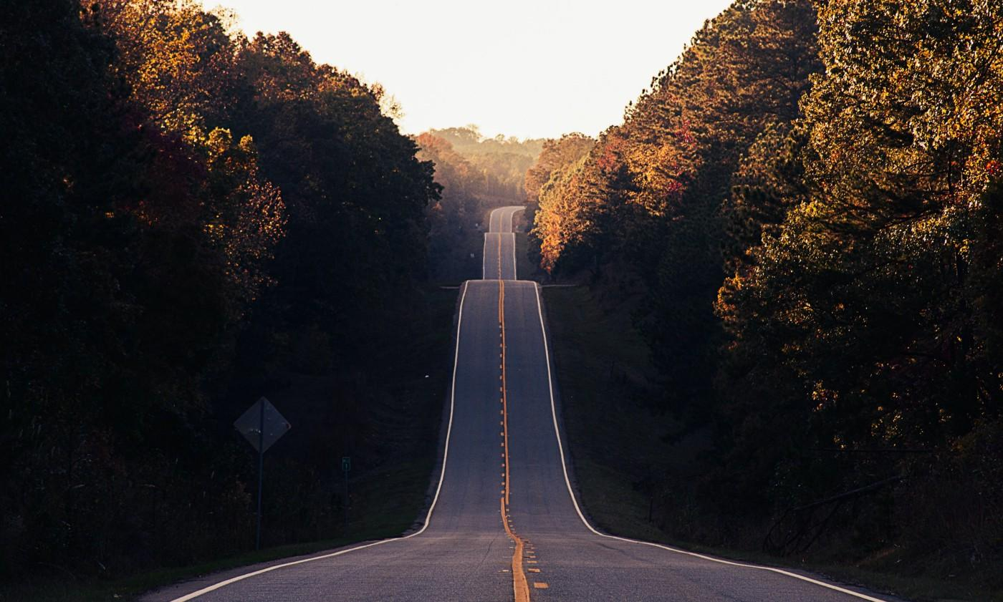

Slide 42
What AI sees
Image is common sight in, e.g., East Coast
Model thinks road is narrowing
Car slows down unexpectedly!
(This was a real effect at a major car company)

Slide 43
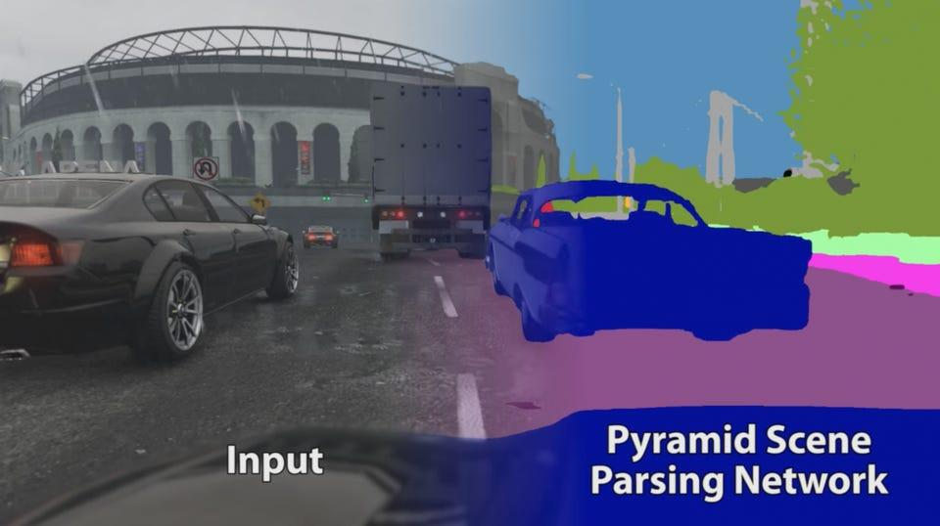
How to make better data?
Create simulations across a wide variety of situations
Ex: Grand Theft Auto 5
Advantages:
Data is pre-labeled (we know what a stop sign is)
Adaptable (could create similar simulations for different countries, environments)
Disadvantage: lack of realism
Stephen Richter

Slide 44
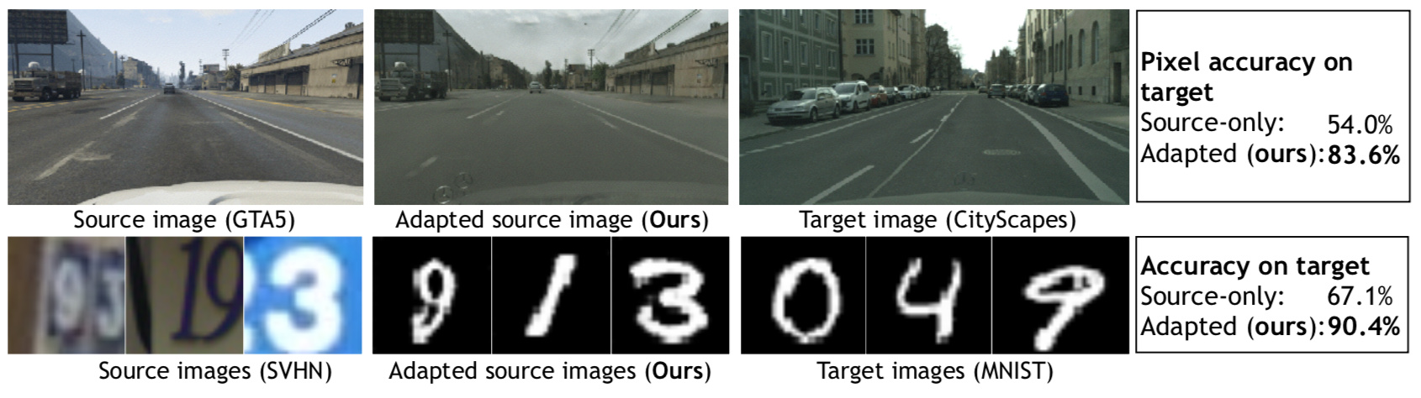
Converting images into new domain
Some groups do not contain enough data for training
CyCADA: generate images for data-poor domain using data-rich domain
Example: self-driving cars need a lot of realistic and labeled images
We have a lot of (automatically labeled) simulations with unrealistic images
Hoffman et al., CyCADA: Cycle-Consistent Adversarial Domain Adaptation. 2018

Slide 45

CyCADA
Hoffman et al., CyCADA: Cycle-Consistent Adversarial Domain Adaptation. 2018

Slide 46
CyCADA
Methodology:
Train model to classify images (e.g., tumor or not, MNIST numbers, etc.,)
Adversarial: generated images such that they are indistinguishable from target domain images
Cycle: make sure we can move from old domain to new and back to old
Keep semantic consistency: label in new and old image should be consistent
Examples in the paper:
Realistic images for training self-driving cars
Google Street View images to written numbers
Create realistic data, but still need to train models

Slide 47

Novelties of method
Advantage:
Extract features expensive to acquire in data-poor domain
More training images with distribution alike to data-poor domain
Cycle = no mode collapse
Contrast with other cycle-based GANs, e.g., CycleGAN
“…digits taken from Google Street View to handwritten digits can…make a printed 8 look like a hand-written 1”

Slide 48
Applications to Fair AI
Goal: create more data for underrepresented classes
Images:
Gender classification
Detecting rashes or melenoma
Non-images too
Any high dimensional data, such as time series (see Hyland et al., 2017)
Especially useful in medicine, where data is heavily protected
Finding more data for underrepresented classes can otherwise be difficult

Slide 49

Group heterogeneity affects models
Ex: accuracy differs when detecting gender in whites and blacks
Models trained on images of Caucasians may work poorly on African-Americans
Accuracy may improve if distributions similar
Similar to batch normalization
Ex: detecting lesions on skin
Dermatologists and AI, trained on/work with many white patients
Might not not spot lesions in black patients
Rashes may look purple, or not readily apparent on non-white skin
Adamson and Smith, 2018
Gorbatenko-Roth et al., 2019

Slide 50

Training Models Across Domains
Treating protected classes as domains may improve accuracy overall

Slide 51


Adversarial Discriminative Domain Adaptation
Pre-training: train classifier on source data
Adversarial adaptation: force feature distributions to be similar
Testing: predict feature from target domain

Slide 52

ADDA Pipeline
Tzeng et al., Adversarial Discriminative Domain Adaptation, 2017

Slide 53



Slide 54
Applications to AI Fairness
If source data is dominated by particular group
Adversarial approach makes feature distributions similar
Might improve fairness, but not its explicit design
Multi-task learning (next slide) or model invariance may be applied in tandem
Advantages of this method
Works for unknown/unlabeled protected groups
Reduces overfitting (model all protected groups at once)
Data agnostic (GANs work on a range of data)

Slide 55
Conclusions
Image fairness suffers from unique problems
Unlabeled data
Untabulated data
Wide heterogeneity (high dimensional data)
Improving AI fairness:
Invariance
Domain adaptation
Multi-task learning
CyCADA: makes more data for protected groups
ADDA: train/test on similar feature distributions

Slide 56
A sneak peak at next class
Detecting data shifts
Other ways to address domain adaptation
Newer methods
Other applications
Utilizing multi-task learning (training models on multiple demographics simultaneously)
Conclusions about image fairness

Slide 57

Fundamental question in fairness
To what degree do we take advantage of universal versus demographic-specific characteristics?
Issue in medical domain
Demographics may be important predictor
E.g., greater likelihood of infant mortality due to systematic racism
Invariant models could counter-intuitively
perform more poorly on some demographics
NYT, 2023

Slide 58

Multi-Task Learning
Apply multi-task learning to find both invariant and domain-specific features (Oneto et al., 2018)
Skin example mentioned previously demonstrates difficulties of domain-invariant models
Method assumes we know protected class labels
Advantage:
May work better for small protected groups
Aims to improve accuracy in all groups rather than overall accuracy

Slide 59

Detecting Data Shifts
Unsupervised methods:
Supervised methods include changes in accuracy – common in fairness settings
https://towardsdatascience.com/understanding-dataset-shift-f2a5a262a766

